Slide 1



Text Classification
ISHITA JAIN
IIT BHU (Varanasi)
Coding the next generation of automation applications

Slide 2
Feature Engineering
Data Cleaning-Ensured that data points for all the classes was close enough and there were no duplicates.
Data Augmentation-Some more data was taken from law insider website along with the points given in problem statement and stored as a csv file. A total of 75 data points were created. Number of data points for each class was same during augmentation.
Input sentences encoding-Done using Bert Tokenizers
Labels encoded using one-hot encoding.
Data visualization-After looking at the dataset, I realized that words like,indemnify was common in indemnification,and defaulting in lender defaulting.But ,this itself was not sufficient to make accurate predictions as different classes might have similar words.

Slide 3
Model Options Considered
RNN Model-RNN model was the first considered option.LSTM models are better then traditional RNN in terms of memory.So, explored and directly implemented on LSTM.
LSTM Model(Artificial RNN)-The performance of the LSTM model on test data was not good.It was overfitting on the training data.It was not the best for capturing the true meaning of words.
Bert model (pretrained on BookCorpus dataset)-The model was not able to fit the training data well. It was underfitting. The accuracy was not so good in this model. It was not able to capture the law terminology which might be the reason for its poor performance. I wanted to pretrain it on some law data so that it gets familiar with the terminology.
Fine tuning bert model(Pretrained on law data)-Finally,the pretrained bert model got familiar with law terminology and was fine tuned with my augmented training data. It produced accurate results and was working well.

Slide 4
Final Solution- Bert Model
Bert, stands for Bidirectional Encoder Representations for Transformers.
Firstly, input data given in the problem statement had some 25 data points which was very less. So, I made some more data points from law insider website and prepared a csv file.The 5 given labels were encoded using one-hot encoding as it was a classic multiclass classification problem.
Input sentences were encoded using Bert Tokenizers. Tokenization is a process to take raw texts and split into tokens, which are numeric data to represent words. Used custom datasets class to feed data into our model.
Transformers gave Bert its increased capacity for understanding context and ambiguity in languages. Bert model pre-trained on law dataset was fine tuned using our training data.

Slide 5
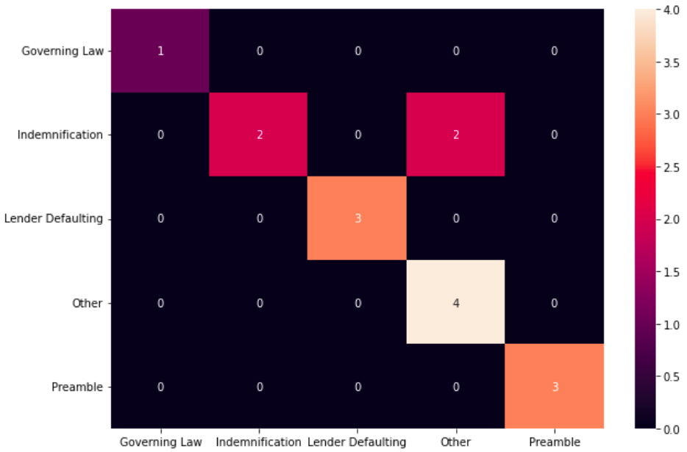
Model Metrics
For the final model: Average values-
Validation accuracy = 90.00%
F1 score(micro) = 0.90
F1 score(macro) = 0.86
Precision = 0.93
Recall = 0.9
Random search was used for the hyperparameter optimization of our model
Accuracy on the training set is 100%
Accuracy on validation set was 80%, but after adding regularization I was able to achieve 90% validation accuracy(which is neither overfitting nor underfitting I believe)
Confusion Matrix

Slide 6
Model comparison
LSTM model pretrained on English Google News 200B corpus | BERT pre-trained on BookCorpus dataset(bert-base-uncased) | BERT pre-trained on multiple Law datasets
Training accuracy: 98.33% Validation accuracy: 46.67% Overfitting | Training accuracy: 75% Validation accuracy: 40% Underfitting | Training accuracy: 100.00% Validation accuracy: 90.00% Best model

Slide 7
Further Improvements
More accuracy can be obtained if we have more data.
Bert can be pre-trained on multiple law datasets and fine tuned using our dataset(As of now we pre- trained it on only one law dataset)
A larger version of Bert might be used which is computationally expensive.
One of the weaknesses when using Bert architecture is that it is limited to 512 tokens,that means the maximum sequence length allowed as input is 512 words.

